Slide 1
Leveraging LLMs and Topic Modeling for Toxicity Classification
Christina Chance, Claire Huang, Haniyeh Ehsani Oskouie, Elizabeth Eyeson, Margaret Capetz
Trigger warning: there are inappropriate and swear words in this slide deck
Notes:
2-4 elizabeth
6-8 Haniyeh
9-11 margaret
12-14 christina
15-17 claire

Slide 2
Abstract
Content moderation and toxicity classification are major tasks with the field due to social implication.
However, it has been shown that bias amplification and the suppression of marginalized communities can occur in popular toxicity classification models.
It is suggested that the positionality of annotators influence the gold standard labels the models learned from, thus propagating annotators bias.
To assesses the impact of annotator positionality we explore topic modeling strategies for content moderation.
We compare the results of fine-tuning BERTweet and ToxiGen’s HateBERT on the full NLPositionality dataset and three topics generated by LDA topic modeling.
Notes:
Elizabeth

Slide 3
Introduction
Motivation: Effective content moderation crucial for social media platforms to mitigate the spread of harmful content - hate speech, self-harm, bullying
Problem: Human annotations in toxicity classification can introduce biases based on annotators' identities, experiences, and societal norms
Goal: exploring the impact of fine-tuning BERTweet + HateBERT on topic-specific subsets of the NLPositionality dataset on its generalization to other platforms
Method: Used topic modeling to find latent themes in toxic and non-toxic tweets
Notes:
Elizabeth

Slide 4
Literature Review
Works such as Adhikari et.al (2022) and Seeberger and Riedhammer (2022) utilize tweets for crisis analysis and classification, leveraging the formulaic nature of toxic language for content moderation
Zosa et.al (2021) experimented with topic-aware models for comment moderation, - topic information improves classification performance and enhances output confidence
Malmasi and Zampier (2017) establish baseline models for hate speech detection on social media platforms with methods like character n-grams and word skip-grams
Deshpande et.al (2021) evaluate the toxicity of dialogue-based language models, - show benefit of persona assignment on toxicity levels
Dahal and Li (2019) gathered tweets by author before running LDA to extract topic models.
Notes:
Elizabeth

Slide 5
Methodology
Notes:
Margaret

Slide 6
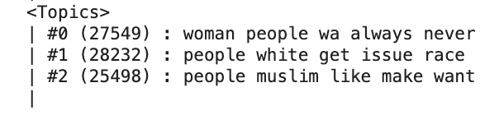
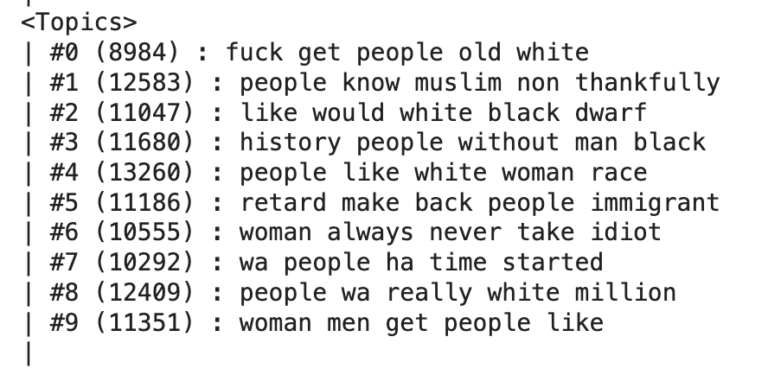
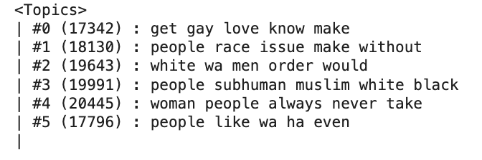
Topic Modeling
Utilized Python library tomotopy to cluster toxicity dataset into 3, 6, 10 topics using Latent Dirichlet Analysis (LDA)
Goal: Split up toxicity dataset into several topics and fine-tune BERTweet and HateBERT on each of those models
Notes:
Haniyeh

Slide 7
Topic Modeling- Topic Distribution Breakdown
 | Topic 0 | Topic 1 | Topic 2 | Total
Not Hate Speech | 739 | 801 | 711 | 2251
Hate Speech | 1261 | 1585 | 1374 | 4220
Not Sure | 197 | 225 | 201 | 623
Total | 2197 | 2611 | 2286 | 7094
Hate : Not Hate Ratio | 0.631 | 0.664 | 0.659 | 0.652
Notes:
Haniyeh

Slide 8

Models
Utilized pretrained models from Hugging Face library
BERTweet was pre-trained on general tweets, HateBERT was trained on hate-speech-specific content
BERTweet
First public large-scale language model pre-trained for English Tweets
Trained based on the RoBERTa pre-training procedure
Corpus
850M English Tweets (16B word tokens ~ 80GB)
845M Tweets streamed from 01/2012 to 08/2019
5M Tweets related to the COVID-19 pandemic.
ToxiGen_HateBERT
English pre-trained BERT model
Obtained by training the English BERT base uncased model
Developed by the collaboration of Microsoft Research, Allen Institute for AI, and Carnegie Mellon University
Corpus
274,186 machine generated toxic and benign statements
98.2% are implicit hate speech
Notes:
Haniyeh

Slide 9
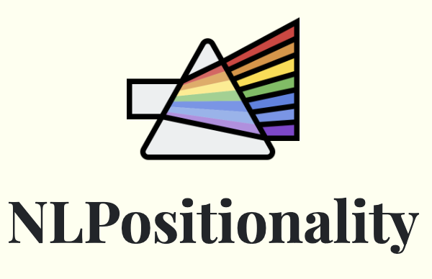
Dataset
NLPositionality Toxicity and Hate Speech Dataset
Demographic metadata from annotators through LabintheWild: age, gender, ethnicity, religion, education, country longest lived in, current country of residence, native language
Labels generated by annotators, dynahate, perspective api, rewire, hateRoBERTa, GPT-4
All other toxicity classification APIs
Labels include {Not Hate Speech, Not Sure, Hate Speech}
7094 instances from the DynaHate Dataset (human in the loop machine generated toxic and hateful statements)
Notes:
Margaret

Slide 10
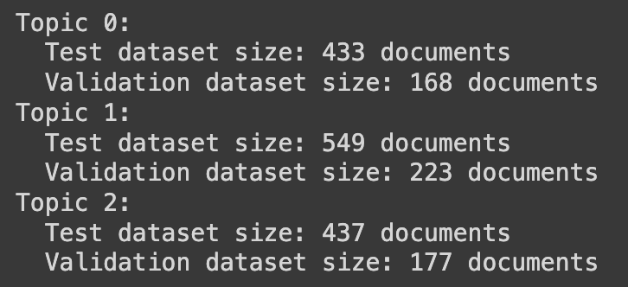
Fine-tuning Overview
Used Python library transformers and its Trainer system to finetune BERTweet and HateBERT
Split dataset into 3 topics based on previous LDA topic modeling
Did not do 6 or 15 due to data subsets becoming too small for analysis
Ran each model for 5 seeds to report average and standard deviation
70 epochs
Adam optimizer
Linear learning rate of 5e-5
Notes:
Margaret

Slide 11
Freezing Layers
Freezing a layer means it will not be trained
Its weights will not be changed
Its weights may already be useful - this may be more relevant for the HateBERT model
Potential benefits
Reducing the risk of overfitting by preserving the generalization ability of the pre-trained model
Saving computational resources and time by avoiding unnecessary calculations and gradient updates
Preventing catastrophic forgetting by preserving the features learned by the pre-trained model that are relevant for the new task
Froze layers
BERTweet - froze RoBERTa layers
HateBERT - froze all the layers but the last one
Comparable results when running on full model and freezing the layer
Frozen layer decreased training time significantly
Conducted all experiments with frozen layers for efficiency
Notes:
Margaret

Slide 12
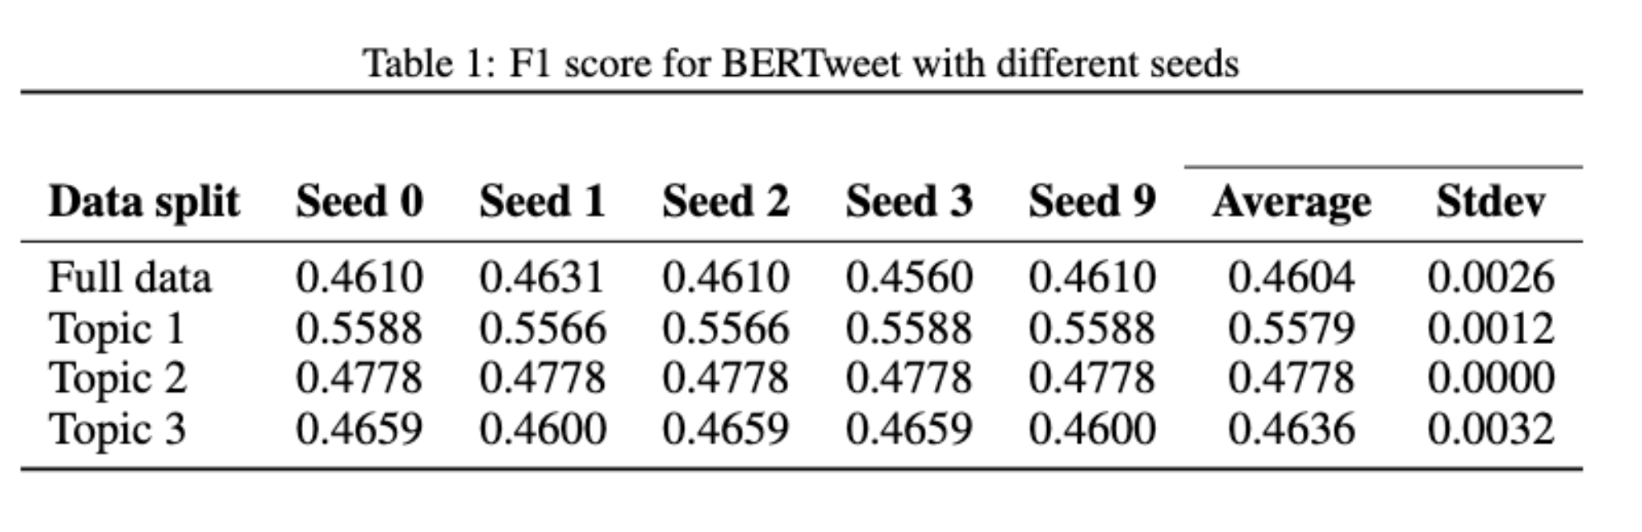
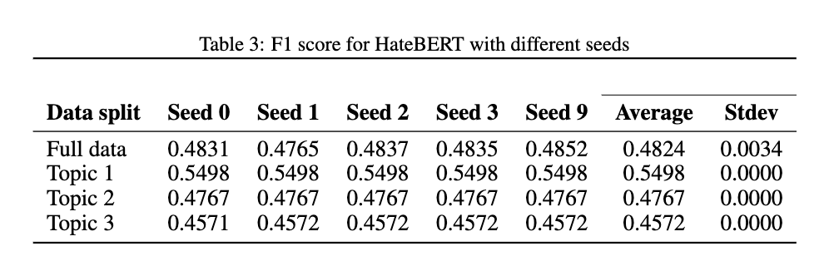
Results
BERTweet
Training on Topic 1 performed the best
Training on Full Dataset performed the worst
HateBert
Training on Topic 1 performed the best
Training on Topic 3 performed the worst
Notes:
Christina

Slide 13
Discussion
Notes:
Christina

Slide 14
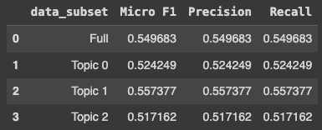
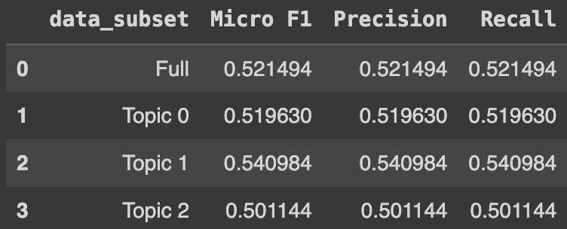
Analysis
Performed majority voting across the seed runs to get predicted labels
Grouped across all data subsets by gender and ethnicity and looked at the confusion matrix
How do model predictions align with different identities as it has to do with toxicity classification
Do these models align more with different identities?
Does the model itself mimic a specific positionality, specifically as it has to do with different toxicity topic clusters?
Between HateBERT and TweetBERT, what pretrained model supports the specific domain of toxicity classification for tweets best?
TweetBERT
HateBERT
Notes:
Christina

Slide 15
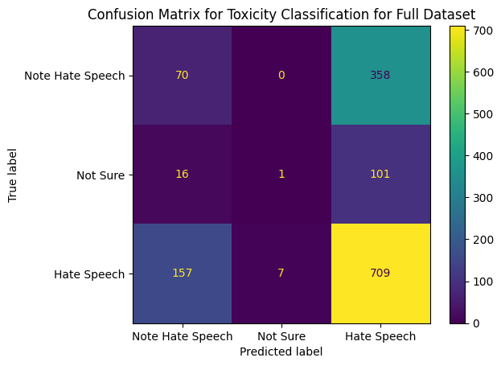
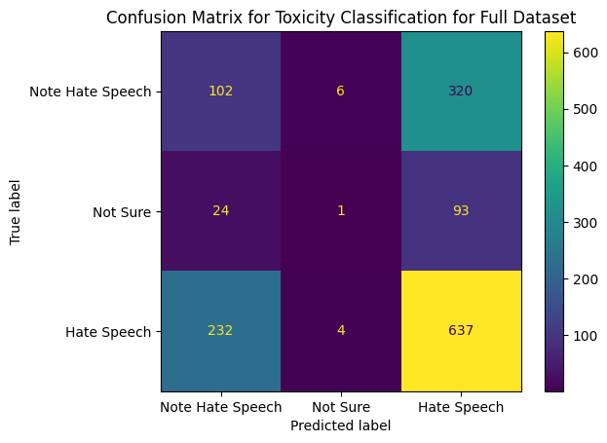
Pretrained Model Confusion Matrix
TweetBERT
HateBERT
Notes:
Christina

Slide 16
Findings
Both models have high false positive rates
Label distribution was skewed
HateBERT was pretrained on implicit toxicity examples while are test set is explicit
TweetBERT has a overall high TPR/recall, especially for Black annotators
Both TweetBERT and HateBERT have high TNR
The breakdown by topic does not produce notable difference in overall model performance suggesting there aren’t topics in hate speech that the model performs better on
HateBERT despite being pretrained on toxicity data does not perform well for this task
Notes:
Christina

Slide 17
Limitations
Topic modeling is not as expressive as necessary due to the variety in tweets
We utilized Tomotopy instead of Gensim as prior work had shown that Tomotopy has more expressive topics
We found that with a large number of topics we had more understandable grouping, but due to the size of the dataset, as well as knowledge that further subsets of the data would be too small for analysis, we decided to use a smaller number of topics
BERTweet was pre-trained on general tweets, which may not be specific enough for our downstream task of training for toxicity classification
HateBERT was pre-trained on a binary toxicity classification dataset, the inclusion of a third label for our dataset during the finetune process may have contributed to the high error rates for that new label
Notes:
Claire

Slide 18
Future Work
Current NLPositionality dataset
Test data splits of 6 and 15 topics to test if the topic granularity effects the F1 score and other statistics
Pre-train on other datasets
Training on a larger corpus may help improve the model
Out-of-domain applications
Test generalizability to other datasets
Test on data from other social media platforms beyond Twitter and Reddit
Notes:
Claire

Slide 19
Conclusion
Motivation: Effective content moderation critical to limit the spread of harmful content on social media platforms
Problem: Human annotations in toxicity classification can introduce biases based on annotators' identities, experiences, and societal norms
Our goal: Explore the impact of fine-tuning BERTweet + HateBERT on topic-specific subsets of the NLPositionality dataset on its generalization to other platforms
Used topic modeling via LDA to find latent themes in toxic and non-toxic tweets
Results
Fine-tuning on specific topics appears to have improved the F1 score of the model
Topic 1 one stood out in terms of performance and reason for this could be further investigated with regards to bias within the split
Notes:
Claire

Slide 20
References
Rabin Adhikari, Safal Thapaliya, Nirajan Basnet, Samip Poudel, Aman Shakya, and Bishesh Khanal.
COVID-19-related Nepali tweets classification in a low resource setting. In Graciela Gonzalez-
Hernandez and Davy Weissenbacher, editors, Proceedings of The Seventh Workshop on Social
Media Mining for Health Applications, Workshop & Shared Task, pages 209–215, Gyeongju,
Republic of Korea, October 2022. Association for Computational Linguistics. URL https:
//aclanthology.org/2022.smm4h-1.52.
Sathish A. P. Kumar Biraj Dahal and Zhenlong Li. Topic modeling and sentiment analysis of global
climate change tweets. Soc. Netw. Anal. Min., 9, 2019. doi: 10.1007/s13278-019-0568-8.
3
Ameet Deshpande, Vishvak Murahari, Tanmay Rajpurohit, Ashwin Kalyan, and Karthik Narasimhan.
Toxicity in chatgpt: Analyzing persona-assigned language models. In Houda Bouamor, Juan Pino,
and Kalika Bali, editors, Findings of the Association for Computational Linguistics: EMNLP
2023, pages 1236–1270, Singapore, December 2023. Association for Computational Linguis-
tics. doi: 10.18653/v1/2023.findings-emnlp.88. URL https://aclanthology.org/2023.
findings-emnlp.88.
Do Yeon Kim, Xiaohang Li, Sheng Wang, Yunying Zhuo, and Roy Ka-Wei Lee. Topic enhanced
word embedding for toxic content detection in q&a sites. In Proceedings of the 2019 IEEE/ACM
International Conference on Advances in Social Networks Analysis and Mining, ASONAM ’19,
page 1064–1071, New York, NY, USA, 2020. Association for Computing Machinery. ISBN
9781450368681. doi: 10.1145/3341161.3345332. URL https://doi.org/10.1145/3341161.
3345332.
Shervin Malmasi and Marcos Zampieri. Detecting hate speech in social media. In Ruslan Mitkov
and Galia Angelova, editors, Proceedings of the International Conference Recent Advances in
Natural Language Processing, RANLP 2017, pages 467–472, Varna, Bulgaria, September 2017.
INCOMA Ltd. doi: 10.26615/978-954-452-049-6_062. URL https://doi.org/10.26615/
978-954-452-049-6_062.
Sebastin Santy, Jenny Liang, Ronan Le Bras, Katharina Reinecke, and Maarten Sap. NLPositionality:
Characterizing design biases of datasets and models. In Anna Rogers, Jordan Boyd-Graber,
and Naoaki Okazaki, editors, Proceedings of the 61st Annual Meeting of the Association for
Computational Linguistics (Volume 1: Long Papers), pages 9080–9102, Toronto, Canada, July
2023. Association for Computational Linguistics. doi: 10.18653/v1/2023.acl-long.505. URL
https://aclanthology.org/2023.acl-long.505.
Philipp Seeberger and Korbinian Riedhammer. Enhancing crisis-related tweet classification with
entity-masked language modeling and multi-task learning. In Laura Biester, Dorottya Demszky,
Zhijing Jin, Mrinmaya Sachan, Joel Tetreault, Steven Wilson, Lu Xiao, and Jieyu Zhao, editors,
Proceedings of the Second Workshop on NLP for Positive Impact (NLP4PI), pages 70–78, Abu
Dhabi, United Arab Emirates (Hybrid), December 2022. Association for Computational Linguistics.
doi: 10.18653/v1/2022.nlp4pi-1.9. URL https://aclanthology.org/2022.nlp4pi-1.9.
Elaine Zosa, Ravi Shekhar, Mladen Karan, and Matthew Purver. Not all comments are equal: Insights
into comment moderation from a topic-aware model, 2021.
Notes:
Claire

